Slide 1

LAPTOP PRICE PREDICTOR
INTRO TO DATA SCIENCE
PROFESSOR : DR. ARIDANA SULA

Slide 2
TEAM 14
-Sai Charan Chandupatla (Team Lead & Data Analyst) -Aryanadh Chowdary Kommineni ( Data Researcher & Engineer) -Bhargavi Karuku (Data Pipeline Developer) -Yash Raythatha (ETL Developer)

Slide 3
CONTENTS
01
02
03
04
05
06
Introduction
Problem Statement
Methodology
Data Pipeline
Modeling
Conclusion

Slide 4
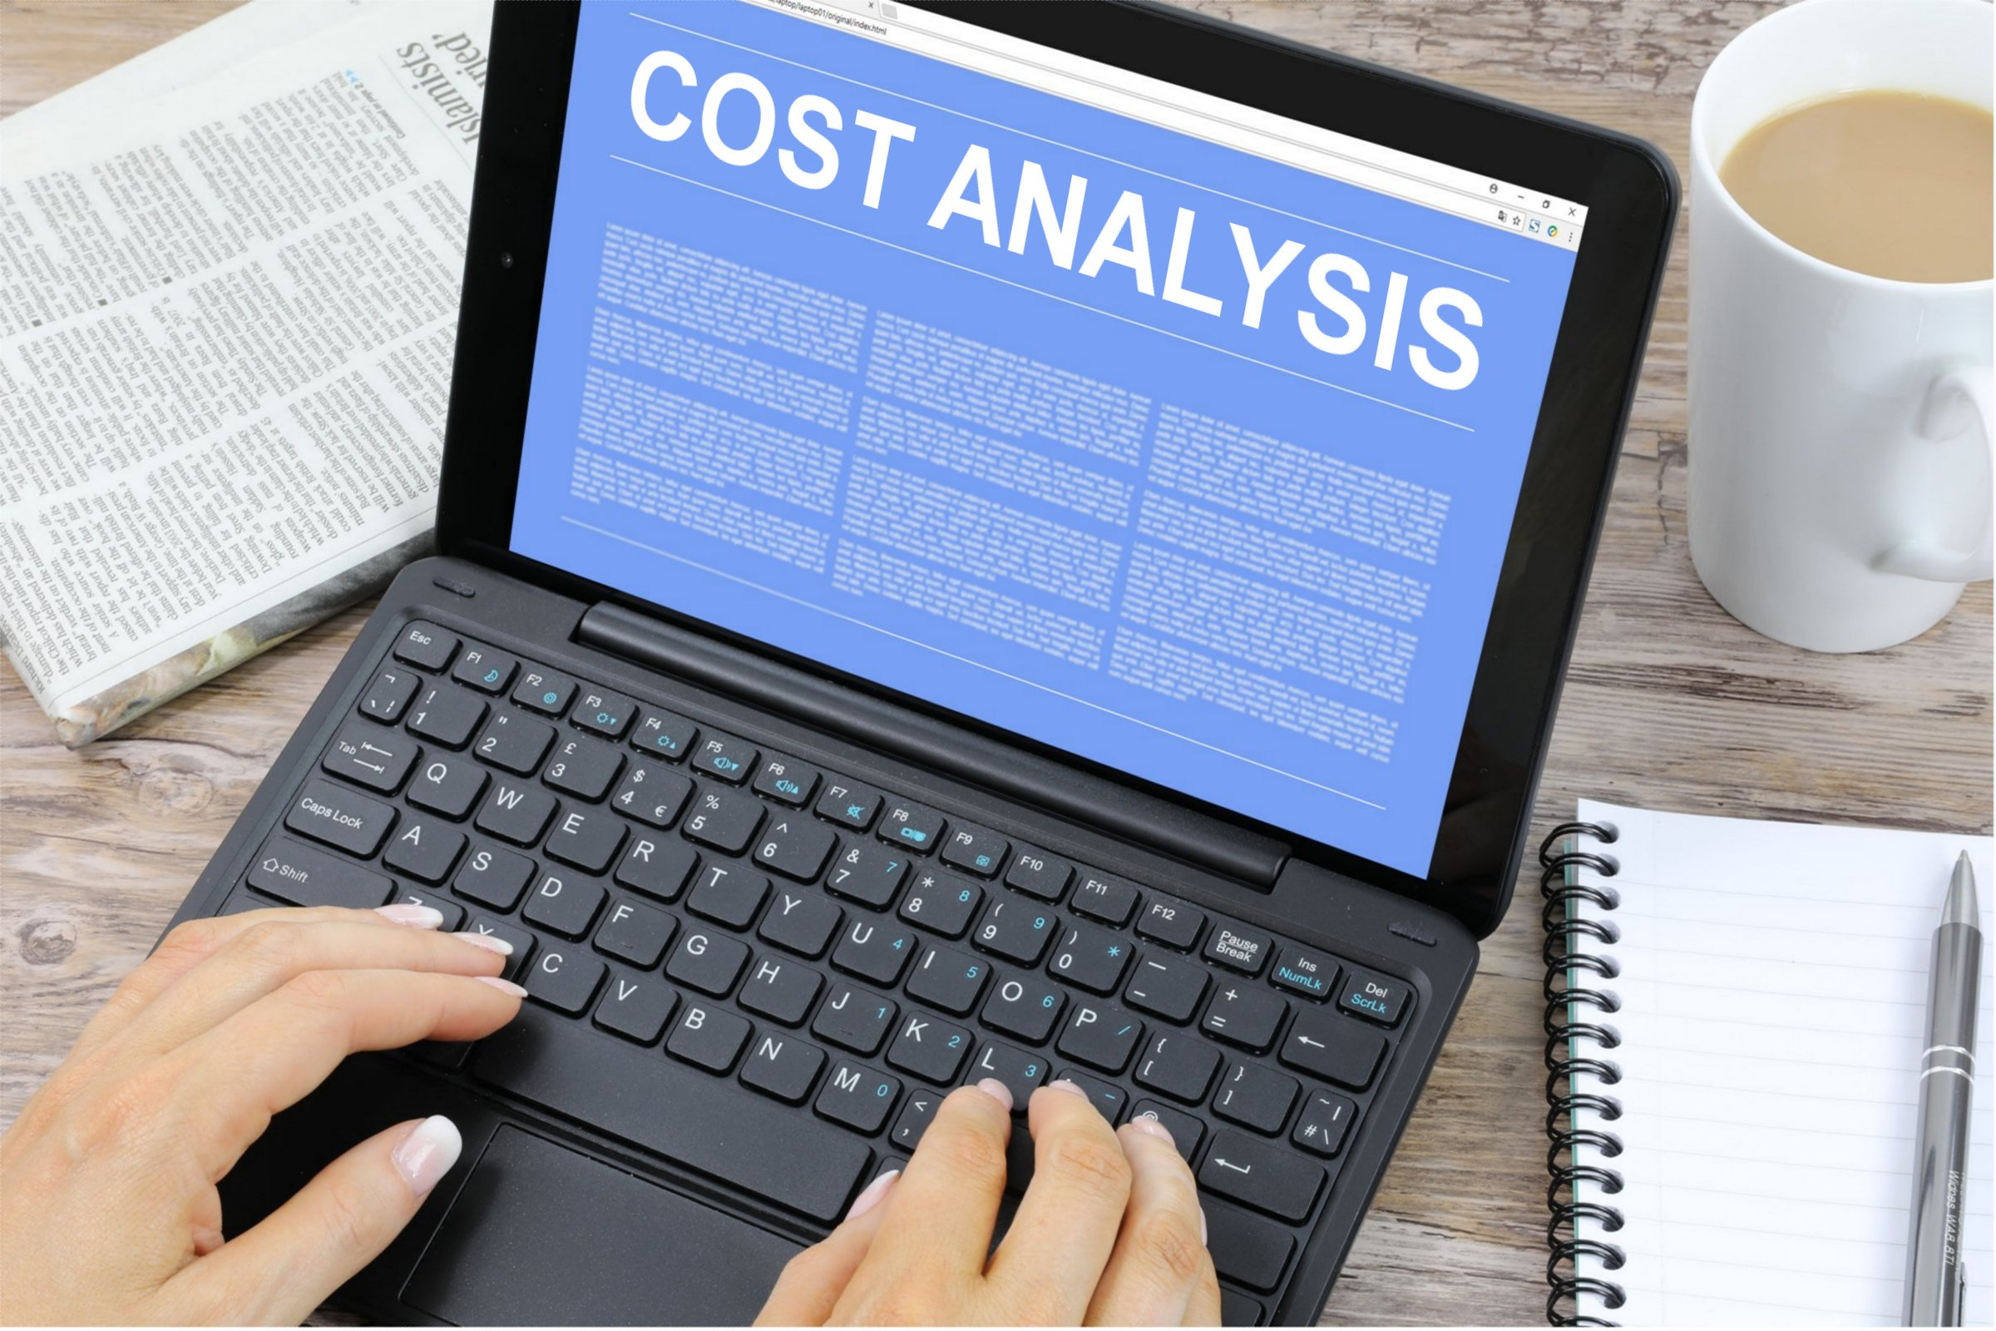
INTRODUCTION
Developing a machine learning model that accurately predicts the market price of laptops based on a set of key specifications. The goal is to create a reliable system that assists both consumers and retailers in estimating the fair market value of a laptop, taking into account various factors such as brand reputation, technical specifications, market trends, and economic indicators.

Slide 5
PROBLEM STATEMENT
With the continuous introduction of new models, varying specifications, and a wide range of brands, consumers often struggle to estimate the fair price of a laptop that meets their requirements.
Developing a reliable laptop price predictor is essential to address this issue and provide potential buyers with a valuable tool for making well-informed purchasing decisions.

Slide 6
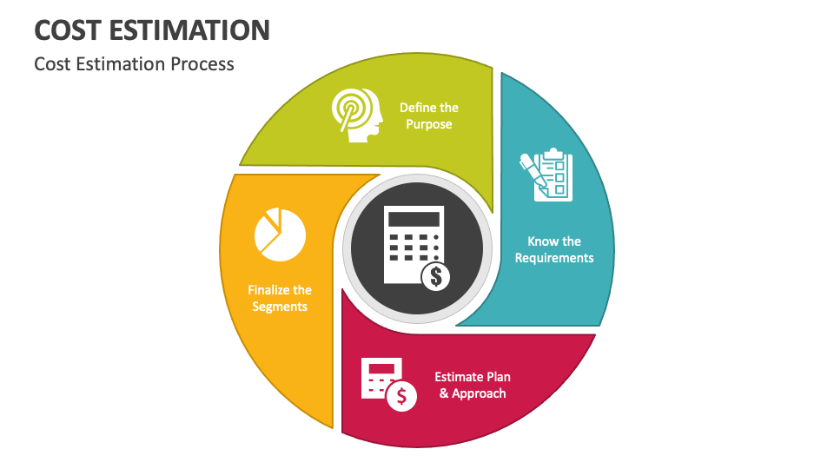
METHODOLOGY
The Cross Industry Standard Process for Data Mining (CRISP-DM) is a process model that serves as the base for a data science process. Business understanding – What does the business need?
Data understanding – What data do we have / need? Is it clean?
Data preparation – How do we organize the data for modeling?
Modeling – What modeling techniques should we apply?
Evaluation – Which model best meets the business objectives?
Deployment – How do stakeholders access the results?

Slide 7

EXPLORATORY DATA ANALYSIS
Exploratory analysis is a process to explore and understand the data and data relationship in a complete depth so that it makes feature engineering and machine learning modeling steps smooth and streamlined for prediction.
EDA helps to prove our assumptions true or false. In other words, it helps to perform hypothesis testing. We will start from the first column and explore each column and understand what impact it creates on the target column.
At the required step, we will also perform preprocessing and feature engineering tasks, our aim in performing in-depth EDA is to prepare and clean data for better machine learning modeling to achieve high performance and generalized models.

Slide 8



TOOLS

Slide 9
BUSINESS UNDERSTANDING
The primary objective is to develop a machine learning model that accurately predicts the prices of laptops based on their specifications and features.
Ultimately, the goal is to enhance the laptop shopping experience for consumers and promote price fairness and competitiveness in the laptop market.

Slide 10

DATA COLLECTION
ATTRIBUTES
Company Name
Type Name
Inches
Screen Resolution
CPU
RAM
Memory
GPU
Operating System
Weight
Price
Dataset: Kaggle

Slide 11
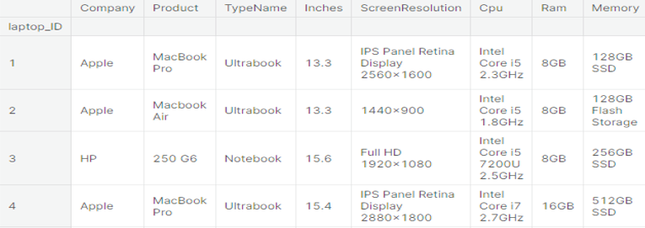
DATASET

Slide 12
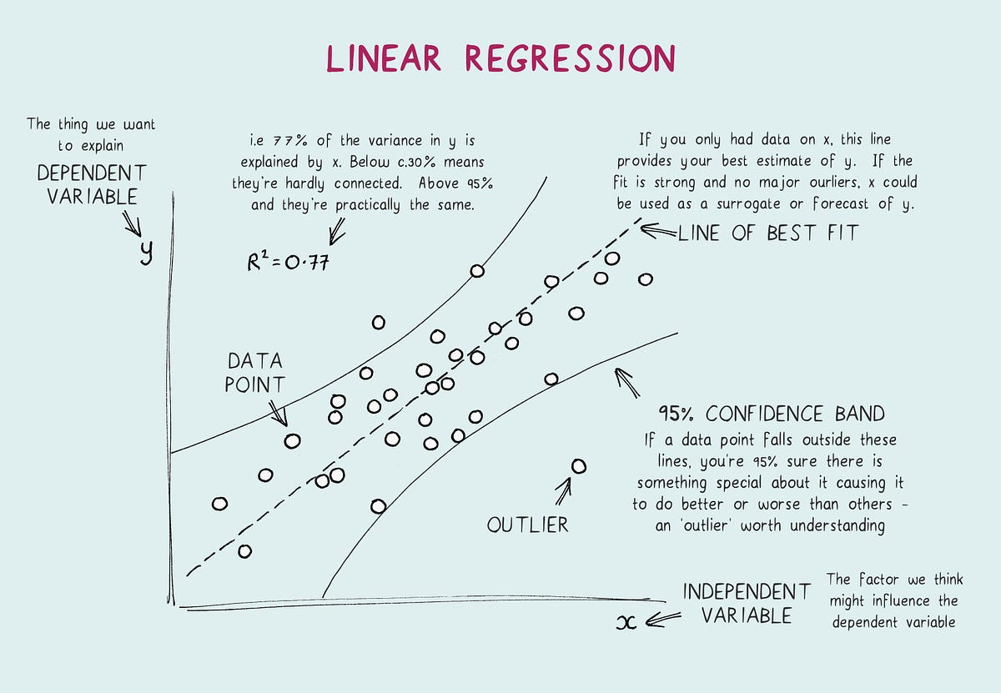
MODELING – Linear Regression
Linear regression is commonly used for predictive analysis and modeling.
Linear regression is a statistical modeling technique used to establish a relationship between a dependent variable and one or more independent variables. It assumes a linear relationship between the variables, where changes in the independent variables lead to proportional changes in the dependent variable.

Slide 13
CONCLUSION
In conclusion, the development of a laptop price prediction model addresses a crucial need in the laptop market, providing consumers with a valuable tool for making informed purchasing decisions.
By leveraging machine learning techniques, this model offers transparency and helps potential buyers estimate the fair price of laptops based on their desired specifications.
Ultimately, this not only enhances the shopping experience but also promotes fairness and efficiency in laptop pricing, benefitting both consumers and the industry.

Slide 14
Link
https://github.com/TEAM-14-Intro-to-Data-Science/Laptop-Price-Predictor

Slide 15
Thankyou

